Slide 1
Task Reminder
MADE BY-
GVA Sashank(B024)
Yashashwini Gupta(B031)
Syed Ashraf Hussain(B036)

Slide 2
Description
Task Reminder is an elegantly designed reminder/alarm application which is easy and pleasant to use. Set reminders for anything with this app, for ex. pills, workouts, groceries, bills, birthdays, etc.

Slide 3
Features
Create alarms, reminders, notifications, etc.
Intuitively designed interface for ease of use
Edit the set alarms , add description for any specific tasks.
Set default name and time for tasks.
Delete the tasks which are not necessary .

Slide 4
Need for the Application
With the introduction of modern lifestyle we seldom forget many important things in our daily lives.
This is where our application comes into play.
“Task Reminder” makes sure that you never miss out any important thing in your life.

Slide 5
Application
Schedules reminders for events like –
Bills
Workouts
Medications
Birthdays
Tests
Meetings
Lectures
Alarms
Submissions
Appointments

Slide 6
Core Competencies
User Friendly
Easy to learn
Attractive UI
Suits all age groups
Notification Access

Slide 7
Functions of various Classes used
ReminderListActivity
This class controls all the functions in the starting screen of the app.
User will have two options here –
1) Add Reminder - clicking on which would lead to list of various common tasks.
2) Settings – by clicking on this option user can set the default name and time for tasks.
Apart from these options, this class also controls the display of tasks. If there are no tasks it would dis-play “No Reminders Yet”, else it would display the titles of the saved tasks.
The previously saved tasks can be deleted by long pressing on its name.

Slide 8
TaskList
When this class is called, a list of all the commonly used tasks like meetings, workouts, homeworks etc… gets displayed . User has to select the preferred task from the options , when its done the screen changes , to Edit Activity which is controlled by ReminderEditAtivity Class.

Slide 9
ReminderEditActivity
This class controls the various attributes of a task like title , date , time and description .
User needs to enter the required info in the respective fields . When its done and user enters “Save”, the entered info gets stored in a local database.

Slide 10
RemindersDbAdapter
This class creates a local database , which stores the title , description , time and date at which user needs to be reminded of the particular task. This class also supplies info to other classes when required to perform a specific function .

Slide 11
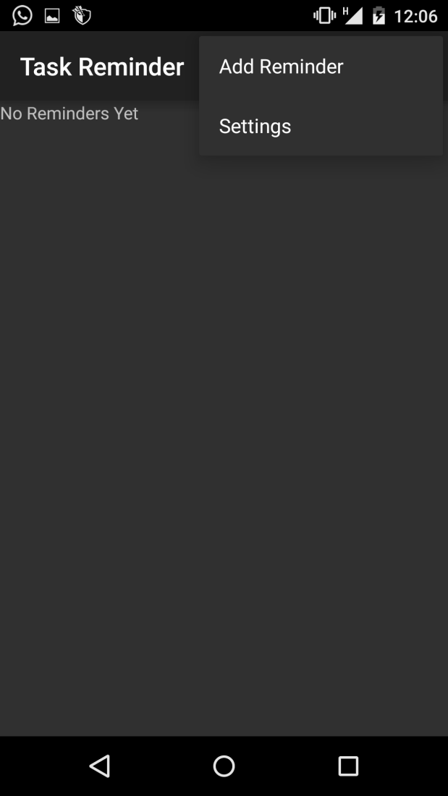

Slide 12
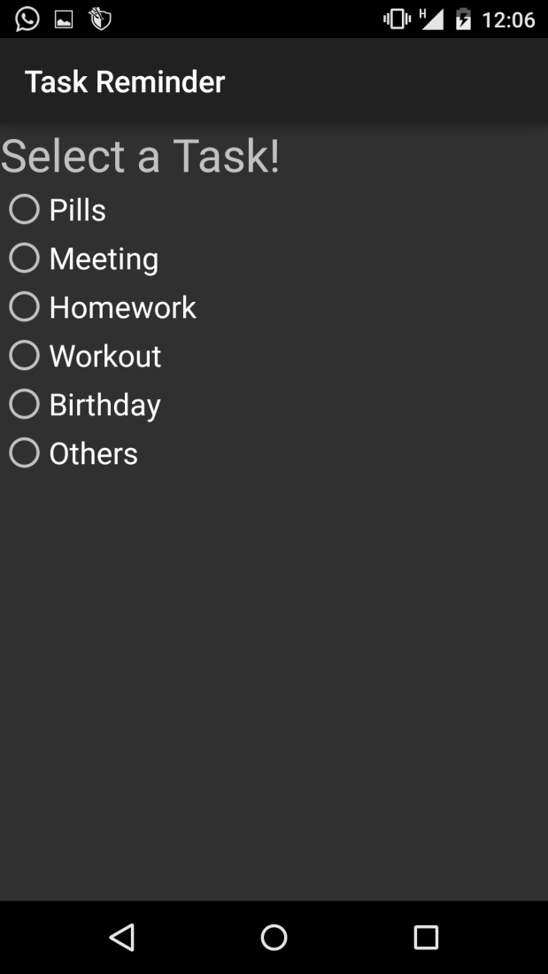

Slide 13
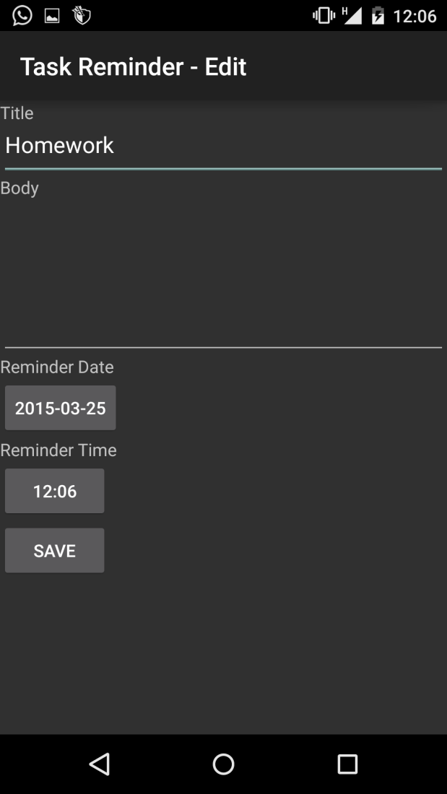

Slide 14
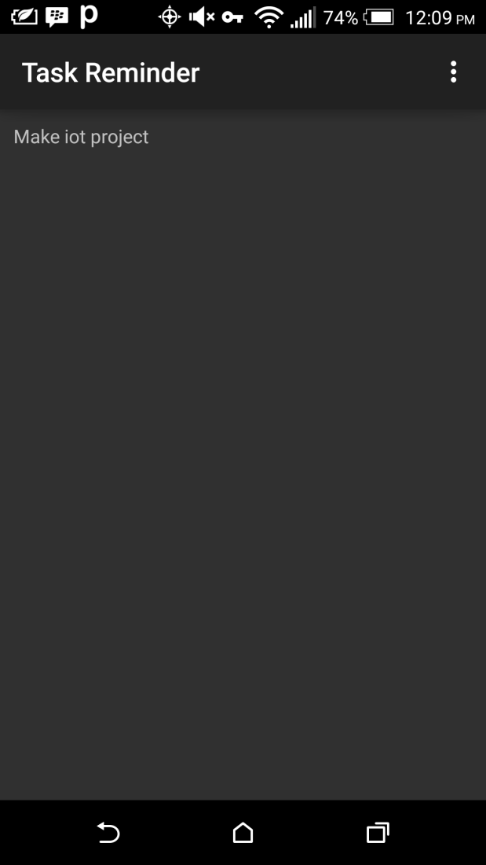

Slide 15
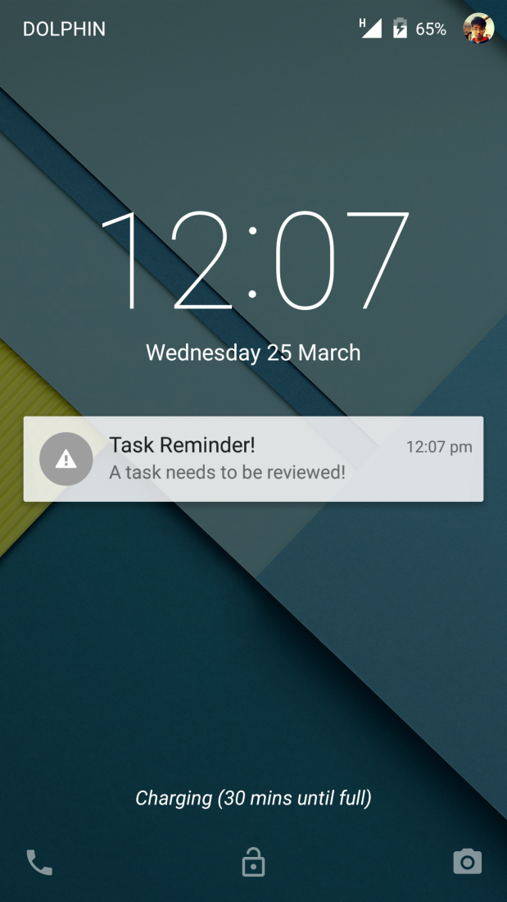

Slide 16
System Requirement
Android Version 4.0(Ice Cream Sandwich)
RAM – 512 MB
Processor – 1Ghz Single Core
Memory Requirement – 10 MB free Space in Device

Slide 17
THANK YOU ☺

